Slide 1
第31組_手寫作業_第N題
N. 證明史坦惹樹問題(Steiner tree problem)為NP問題。
組員:劉邦均 107501525
羅世辰 107501526
吳叡青 107501534

Slide 2
Steiner tree problem
Instance:
an undirected graph G = (V, E);
a subset of the vertices R ⊆ V , called terminal nodes;
a number k ∈ N.
Question:
Is there a subtree of G that includes all the vertices of R (i.e. a spanning tree for R) and that contains at most k edges?

Slide 3
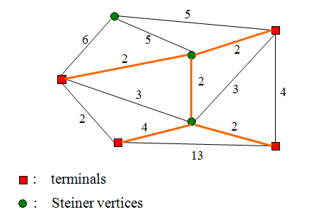
Steiner tree problem
terminals 為題目指定的點集合 R ⊆ V
-> 若題目指定 k = 4 , 則答案為 No (5>4)
-> 若題目指定 k = 7 , 則答案為 Yes(5<7)

Slide 4
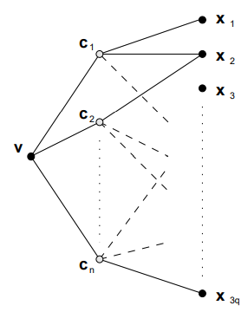
證明思路
已知 Exact Cover by 3-Sets (X3C) 問題是一個著名的 NP-complete problem
利用X3C問題與ST問題相似的特性，將X3C問題轉變為ST問題
Instance:
• a finite set X with |X| = 3q;
• a collection C of 3-element subsets of X,
C = {C1, · · · , Cn} Ci ⊆ X, |Ci | = 3 1 ≤ i ≤ n;
Question:
Does C contain an exact cover for X, that is,
a subcollection C’ ⊆ C such that every element of
X occurs in exactly one member of C’ ?

Slide 5
References
[1] Alessandro Santuari. Steiner Tree NP-completeness Proof. May 7, 2003

